Slide 1
CSCE430/830 Computer Architecture
Pipeline: Hazards
Lecturer: Prof. Hong Jiang
Courtesy of Prof. Yifeng Zhu, U. of Maine
Fall, 2006
Portions of these slides are derived from:
Dave Patterson © UCB

Slide 2
Pipelining Outline
Introduction
  Defining Pipelining
  Pipelining Instructions
Hazards
  Structural hazards 
  Data Hazards
  Control Hazards
Performance
Controller implementation

Slide 3
Pipeline Hazards
Where one instruction cannot immediately follow another
Types of hazards
  Structural hazards - attempt to use the same resource by two or more instructions
  Control hazards - attempt to make branching decisions before branch condition is evaluated
  Data hazards - attempt to use data before it is ready
Can always resolve hazards by waiting

Slide 4
Structural Hazards
Attempt to use the same resource by two or more instructions at the same time
Example: Single Memory for instructions and data
  Accessed by IF stage
  Accessed at same time by MEM stage
Solutions
  Delay the second access by one clock cycle, OR
  Provide separate memories for instructions & data
    This is what the book does
    This is called a “Harvard Architecture”
    Real pipelined processors have separate caches

Slide 5
Pipelined Example -
Executing Multiple Instructions
Consider the following instruction sequence:
    lw $r0, 10($r1)
    sw $sr3, 20($r4)
    add $r5, $r6, $r7
    sub $r8, $r9, $r10

Slide 6
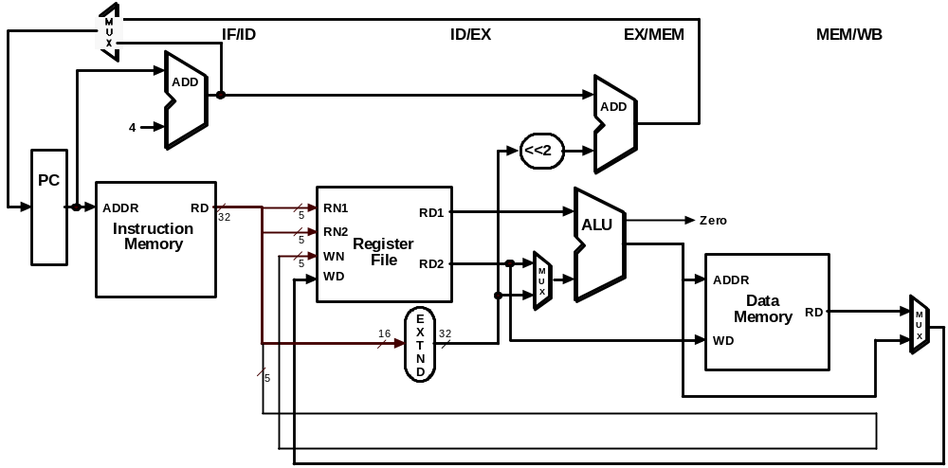
Executing Multiple Instructions
Clock Cycle 1
LW

Slide 7
Executing Multiple Instructions
Clock Cycle 2
SW
LW

Slide 8
Executing Multiple Instructions
Clock Cycle 3
ADD
SW
LW

Slide 9
Executing Multiple Instructions
Clock Cycle 4
SUB
ADD
SW
LW

Slide 10
Executing Multiple Instructions
Clock Cycle 5
SUB
ADD
SW
LW

Slide 11
Executing Multiple Instructions
Clock Cycle 6
SUB
ADD
SW

Slide 12
Executing Multiple Instructions
Clock Cycle 7
SUB
ADD

Slide 13
Executing Multiple Instructions
Clock Cycle 8
SUB

Slide 14
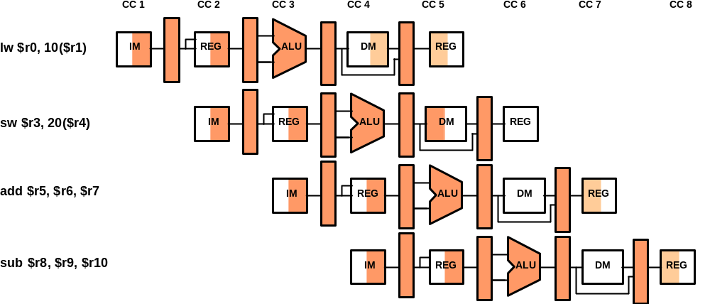
Alternative View - Multicycle Diagram

Slide 15
Alternative View - Multicycle Diagram
Memory Conflict

Slide 16
One Memory Port Structural Hazards
Time (clock cycles)
Cycle 1
Cycle 2
Cycle 3
Cycle 4
Cycle 5
Cycle 6
Cycle 7
I
n
s
t
r.
O
r
d
e
r
Load
Ifetch
Reg
ALU
DMem
Reg
Instr 1
Ifetch
Reg
ALU
DMem
Reg
Instr 2
Ifetch
Reg
ALU
DMem
Reg
Stall
Bubble
Bubble
Bubble
Bubble
Bubble
Instr 3
Ifetch
Reg
ALU
DMem
Reg

Slide 17
Structural Hazards
Some common Structural Hazards:
Memory:
  we’ve already mentioned this one.
Floating point:
  Since many floating point instructions require many cycles, it’s easy for them to interfere with each other.
Starting up more of one type of instruction than there are resources.
  For instance, the PA-8600 can support two ALU + two load/store instructions per cycle - that’s how much hardware it has available.

Slide 18
Structural Hazards
Dealing with Structural Hazards
Stall
low cost, simple
Increases CPI
use for rare case since stalling has performance effect
Pipeline hardware resource
useful for multi-cycle resources
good performance
sometimes complex e.g., RAM
Replicate resource
good performance
increases cost (+ maybe interconnect delay)
useful for cheap or divisible resources

Slide 19
Structural Hazards
Structural hazards are reduced with these rules:
  Each instruction uses a resource at most once
  Always use the resource in the same pipeline stage
  Use the resource for one cycle only
Many RISC ISAs are designed with this in mind
Sometimes very difficult to do this.
  For example, memory of necessity is used in the IF and MEM stages.

Slide 20
Structural Hazards
We want to compare the performance of two machines. Which machine is faster?
Machine A: Dual ported memory - so there are no memory stalls
Machine B: Single ported memory, but its pipelined implementation has a clock rate that is 1.05 times faster
Assume:
Ideal CPI = 1 for both
Loads are 40% of instructions executed

Slide 21


Speed Up Equations for Pipelining
For simple RISC pipeline, CPI = 1:

Slide 22
Structural Hazards
We want to compare the performance of two machines. Which machine is faster?
Machine A: Dual ported memory - so there are no memory stalls
Machine B: Single ported memory, but its pipelined implementation has a 1.05 times faster clock rate
Assume:
Ideal CPI = 1 for both
Loads are 40% of instructions executed
SpeedUp_{A} = Pipeline Depth/(1 + 0) x (clock_{unpipe}/clock_{pipe})
= Pipeline Depth
SpeedUp_{B} = Pipeline Depth/(1 + 0.4 x 1)
x (clock_{unpipe}/(clock_{unpipe} / 1.05)
= (Pipeline Depth/1.4) x 1.05
= 0.75 x Pipeline Depth
SpeedUp_{A} / SpeedUp_{B} = Pipeline Depth / (0.75 x Pipeline Depth) = 1.33
Machine A is 1.33 times faster

Slide 23
Pipelining Summary
Speed Up <= Pipeline Depth; if ideal CPI is 1, then:
Hazards limit performance on computers:
  Structural: need more HW resources
  Data (RAW,WAR,WAW)
  Control
Pipeline Depth
Clock Cycle Unpipelined
Speedup =
X
1 + Pipeline stall CPI
Clock Cycle Pipelined

Slide 24
Review
Speedup of pipeline
Pipeline Depth
Clock Cycle Unpipelined
Speedup =
X
1 + Pipeline stall CPI
Clock Cycle Pipelined

Slide 25
Pipelining Outline
Introduction
  Defining Pipelining
  Pipelining Instructions
Hazards
  Structural hazards
  Data Hazards 
  Control Hazards
Performance
Controller implementation

Slide 26
Pipeline Hazards
Where one instruction cannot immediately follow another
Types of hazards
  Structural hazards - attempt to use same resource twice
  Control hazards - attempt to make decision before condition is evaluated
  Data hazards - attempt to use data before it is ready
Can always resolve hazards by waiting

Slide 27
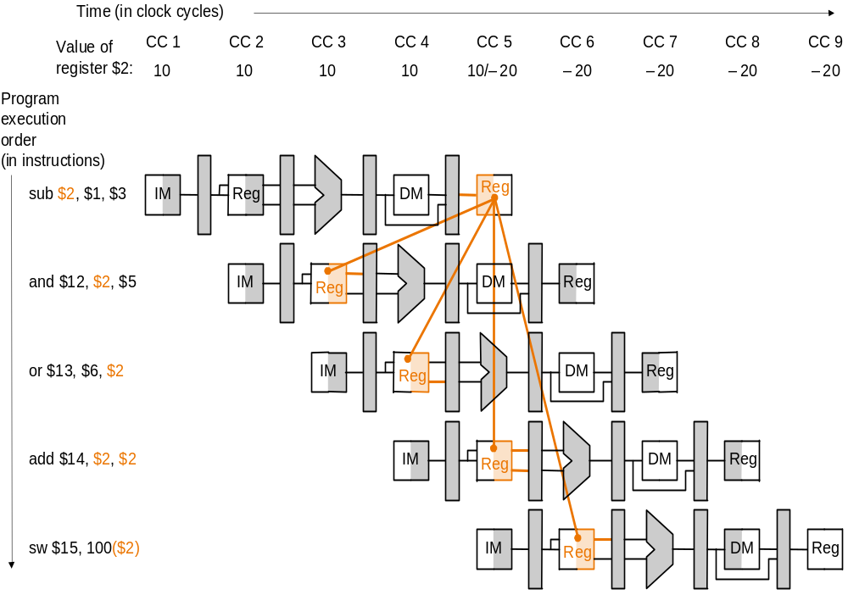
Data Hazards
Data hazards occur when data is used before it is ready
The use of the result of the SUB instruction in the next three instructions causes a data hazard, since the register $2 is not written until after those instructions read it.

Slide 28
Data Hazards
Execution Order is:
Instr_{I}
Instr_{J}
Read After Write (RAW)
Instr_{J} tries to read operand before Instr_{I} writes it
Caused by a “Dependence” (in compiler nomenclature). This hazard results from an actual need for communication.
I: add r1,r2,r3
J: sub r4,r1,r3

Slide 29
Data Hazards
Execution Order is:
Instr_{I}
Instr_{J}
Write After Read (WAR)
Instr_{J} tries to write operand before Instr_{I} reads i
  Gets wrong operand
  Called an “anti-dependence” by compiler writers.
  This results from reuse of the name “r1”.
Can’t happen in MIPS 5 stage pipeline because:
  All instructions take 5 stages, and
  Reads are always in stage 2, and
  Writes are always in stage 5
I: sub r4,r1,r3
J: add r1,r2,r3
K: mul r6,r1,r7

Slide 30
Data Hazards
Execution Order is:
Instr_{I}
Instr_{J}
Write After Write (WAW)
Instr_{J} tries to write operand before Instr_{I} writes it
  Leaves wrong result ( Instr_{I} not Instr_{J} )
Called an “output dependence” by compiler writers
This also results from the reuse of name “r1”.
Can’t happen in MIPS 5 stage pipeline because:
  All instructions take 5 stages, and
  Writes are always in stage 5
Will see WAR and WAW later in more complicated pipes
I: sub r1,r4,r3
J: add r1,r2,r3
K: mul r6,r1,r7

Slide 31
Data Hazard Detection in MIPS (1)
Read after Write
IF/ID
ID/EX
EX/MEM
MEM/WB
1a: EX/MEM.RegisterRd = ID/EX.RegisterRs
1b: EX/MEM.RegisterRd = ID/EX.RegisterRt
2a: MEM/WB.RegisterRd = ID/EX.RegisterRs
2b: MEM/WB.RegisterRd = ID/EX.RegisterRt
EX hazard
MEM hazard

Slide 32
Data Hazards
Solutions for Data Hazards
  Stalling
  Forwarding:
    connect new value directly to next stage
  Reordering

Slide 33
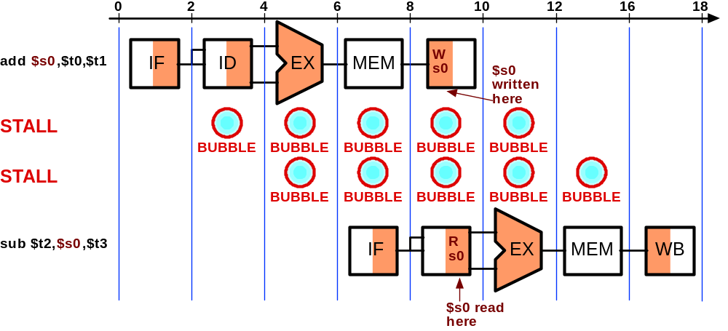
Data Hazard - Stalling

Slide 34
Data Hazards - Stalling
Simple Solution to RAW
Hardware detects RAW and stalls
Assumes register written then read each cycle
  + low cost to implement, simple
  -- reduces IPC
Try to minimize stalls
Minimizing RAW stalls
Bypass/forward/short­circuit (We will use the word “forward”)
Use data before it is in the register
  + reduces/avoids stalls
  -- complex
Crucial for common RAW hazards

Slide 35
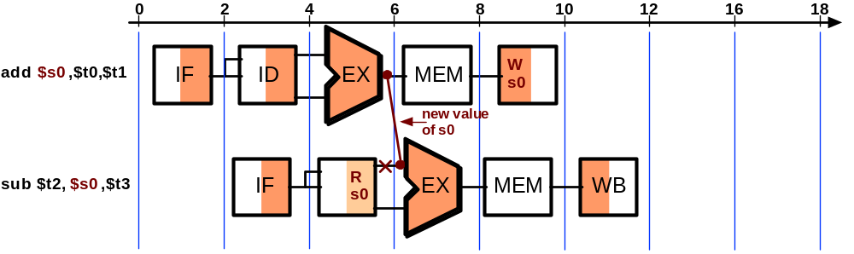
Data Hazards - Forwarding
Key idea: connect new value directly to next stage
Still read s0, but ignore in favor of new result
Problem: what about load instructions?

Slide 36
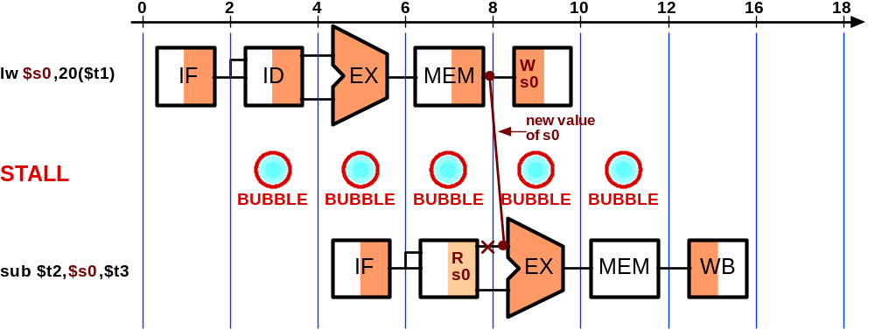
Data Hazards - Forwarding
STALL still required for load - data avail. after MEM
MIPS architecture calls this delayed load, initial implementations required compiler to deal with this

Slide 37
Data Hazards
This is another representation of the stall.
LW R1, 0(R2) | IF | ID | EX | MEM | WB
SUB R4, R1, R5 |  | IF | ID | EX | MEM | WB
AND R6, R1, R7 |  |  | IF | ID | EX | MEM | WB
OR R8, R1, R9 |  |  |  | IF | ID | EX | MEM | WB
LW R1, 0(R2) | IF | ID | EX | MEM | WB
SUB R4, R1, R5 |  | IF | ID | stall | EX | MEM | WB
AND R6, R1, R7 |  |  | IF | stall | ID | EX | MEM | WB
OR R8, R1, R9 |  |  |  | stall | IF | ID | EX | MEM | WB

Slide 38
Forwarding
Key idea: connect data internally before it's stored
IF/ID
ID/EX
EX/MEM
MEM/WB
How would you design the forwarding?

Slide 39
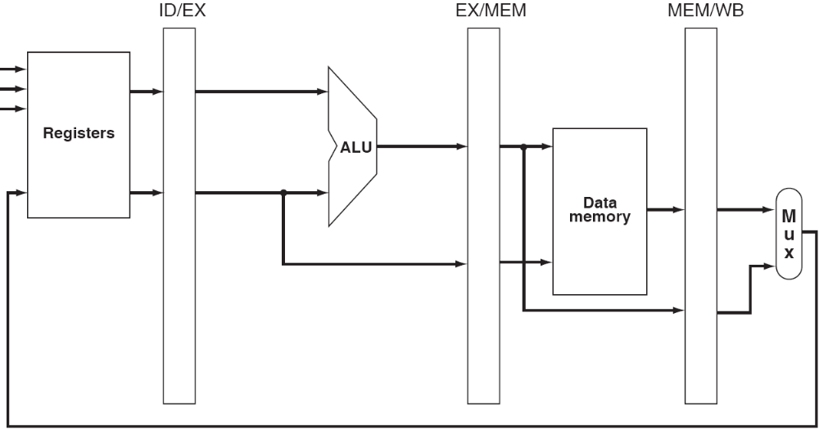
No Forwarding

Slide 40
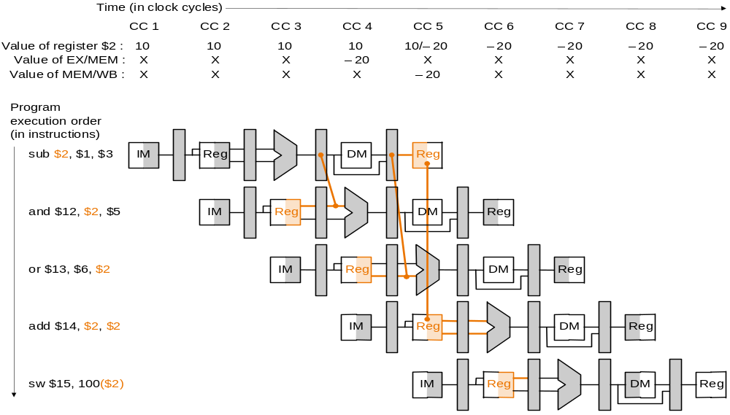
Data Hazard Solution: Forwarding
Key idea: connect data internally before it's stored
Assumption:
  The register file forwards values that are read and written during the same cycle.

Slide 41
Data Hazard Summary
Three types of data hazards
  RAW (MIPS)
  WAW (not in MIPS)
  WAR (not in MIPS)
Solution to RAW in MIPS
  Stall
  Forwarding
    Detection & Control
      EX hazard
      MEM hazard
    A stall is needed if read a register after a load instruction that writes the same register.
  Reordering

Slide 42
Review
Speedup of pipeline
Pipeline Depth
Clock Cycle Unpipelined
Speedup =
X
1 + Pipeline stall CPI
Clock Cycle Pipelined

Slide 43
Pipelining Outline
Introduction
  Defining Pipelining
  Pipelining Instructions
Hazards
  Structural hazards
  Data Hazards 
  Control Hazards
Performance
Controller implementation

Slide 44
Data Hazard Review
Three types of data hazards
  RAW (in MIPS and all others)
  WAW (not in MIPS but many others)
  WAR (not in MIPS but many others)
Forwarding

Slide 45
Review: Data Hazards & Forwarding
SUB $s0, $t0, $t1 ;$s0 = $t0 - $t1
ADD $t2, $s0, $t3 ;$t2 = $s0 + $t3
1 2 3 4 5 6
SUB
ADD
IF | ID | EX | MEM | WB
 | IF | ID | EX | MEM | WB
EX Hazard: SUB result not written until its WB, ready at end of its EX, needed at start of ADD’s EX
EX/MEM Forwarding: forward $s0 from EX/MEM to ALU input in ADD EX stage (CC4)
Note: can occur in sequential instructions

Slide 46
Review: Data Hazards & Forwarding
SUB $s0, $t0, $t1 ;$s0 = $t0 - $t1
ADD $t2, $s0, $t3 ;$t2 = $s0 + $t3
1 2 3 4 5 6
SUB
ADD
IF | ID | EX | MEM | WB
 | IF | ID | EX | MEM | WB
EX Hazard Detection - EX/MEM Forwarding Conditions:
If ((EX/MEM.RegWrite = 1) & (EX/MEM.RegRD = ID/EX.RegRS))
If ((EX/MEM.RegWrite = 1) & (EX/MEM.RegRD = ID/EX.RegRT))
Then forward EX/MEM result to EX stage
Note: In PH3, also check that EX/MEM.RegRD ≠ 0

Slide 47
Review: Data Hazards & Forwarding
SUB $s0, $t4, $s3 ;$s0 = $t4 + $s3
ADD $t2, $s1, $t1 ;$t2 = $s0 + $t1
OR $s2, $t3, $s0 ;$s2 = $t3 OR $s0
1 2 3 4 5 6
SUB
ADD
OR
IF | ID | EX | MEM | WB
 | IF | ID | EX | MEM | WB
 |  | IF | ID | EX | MEM | WB
MEM Hazard: SUB result not written until its WB, stored in MEM/WB, needed at start of OR’s EX
MEM/WB Forwarding: forward $s0 from MEM/WB to ALU input in OR EX stage (CC5)
Note: can occur in instructions I_{n} & I_{n+2}

Slide 48
Review: Data Hazards & Forwarding
SUB $s0, $t4, $s3 ;$s0 = $t4 + $s3
ADD $t2, $s1, $t1 ;$t2 = $s0 + $t1
OR $s2, $t3, $s0 ;$s2 = $t3 OR $s0
1 2 3 4 5 6
SUB
ADD
OR
IF | ID | EX | MEM | WB
 | IF | ID | EX | MEM | WB
 |  | IF | ID | EX | MEM | WB
MEM Hazard Detection - MEM/WB Forwarding Conditions:
If ((MEM/WB.RegWrite = 1) & (MEM/WB.RegRD = ID/EX.RegRS))
If ((EX/MEM.RegWrite = 1) & (EX/MEM.RegRD = ID/EX.RegRT))
Then forward MEM/WB result to EX stage
Note: In PH3, also check that MEM/WB.RegRD ≠ 0

Slide 49
Data Hazard Detection in MIPS
Read after Write
IF/ID
ID/EX
EX/MEM
MEM/WB
1a: EX/MEM.RegisterRd = ID/EX.RegisterRs
1b: EX/MEM.RegisterRd = ID/EX.RegisterRt
2a: MEM/WB.RegisterRd = ID/EX.RegisterRs
2b: MEM/WB.RegisterRd = ID/EX.RegisterRt
EX hazard
MEM hazard
Problem?
Some instructions do not write register.
EX/MEM.RegWrite must be asserted!

Slide 50
Data Hazards
Solutions for Data Hazards
  Stalling
  Forwarding:
    connect new value directly to next stage
  Reordering

Slide 51
Data Hazard - Stalling

Slide 52
Data Hazard Solution: Forwarding
Key idea: connect data internally before it's stored
Assumption:
  The register file forwards values that are read and written during the same cycle.

Slide 53
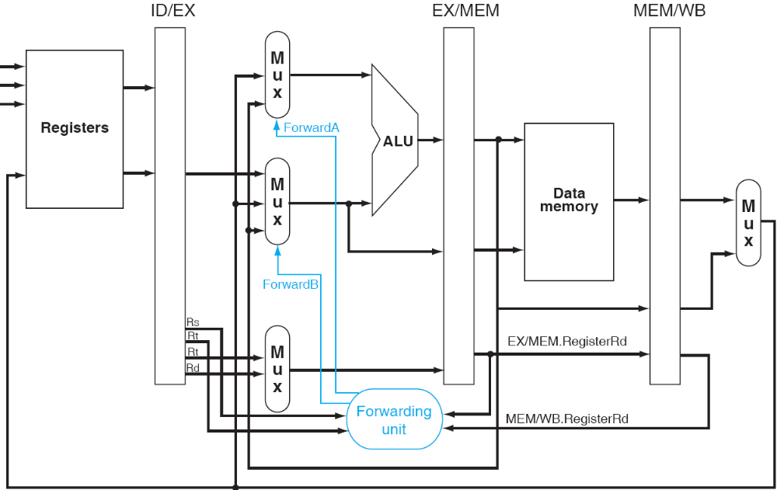
Forwarding
00
01
10
00
01
10
Add hardware to feed back ALU and MEM results to both ALU inputs

Slide 54
Controlling Forwarding
Need to test when register numbers match in rs, rt, and rd fields stored in pipeline registers
"EX" hazard:
  EX/MEM - test whether instruction writes register file and examine rd register
  ID/EX - test whether instruction reads rs or rt register and matches rd register in EX/MEM
"MEM" hazard:
  MEM/WB - test whether instruction writes register file and examine rd (rt) register
  ID/EX - test whether instruction reads rs or rt register and matches rd (rt) register in EX/MEM

Slide 55
Forwarding Unit Detail -
EX Hazard
if (EX/MEM.RegWrite)
and (EX/MEM.RegisterRd ≠ 0)
and (EX/MEM.RegisterRd = ID/EX.RegisterRs))
ForwardA = 10
if (EX/MEM.RegWrite)
and (EX/MEM.RegisterRd ≠ 0)
and (EX/MEM.RegisterRd = ID/EX.RegisterRt))
ForwardB = 10

Slide 56
Forwarding Unit Detail -
MEM Hazard
if (MEM/WB.RegWrite)
and (MEM/WB.RegisterRd ≠ 0)
and (MEM/WB.RegisterRd = ID/EX.RegisterRs))
ForwardA = 01
if (MEM/WB.RegWrite)
and (MEM/WB.RegisterRd ≠ 0)
and (MEM/WB.RegisterRd = ID/EX.RegisterRt))
ForwardB = 01

Slide 57
Data Hazards and Stalls
So far, we’ve only addressed “potential” data hazards, where the forwarding unit was able to detect and resolve them without affecting the performance of the pipeline.
There are also “unavoidable” data hazards, which the forwarding unit cannot resolve, and whose resolution does affect pipeline performance.
We thus add a (unavoidable) hazard detection unit, which detects them and introduces stalls to resolve them.

Slide 58
Data Hazards & Stalls
Identify the true data hazard in this sequence:
LW $s0, 100($t0) ;$s0 = memory value
ADD $t2, $s0, $t3 ;$t2 = $s0 + $t3
1 2 3 4 5 6
LW
ADD
IF | ID | EX | MEM | WB
 | IF | ID | EX | MEM | WB

Slide 59
Data Hazards & Stalls
Identify the true data hazard in this sequence:
LW $s0, 100($t0) ;$s0 = memory value
ADD $t2, $s0, $t3 ;$t2 = $s0 + $t3
1 2 3 4 5 6
LW
ADD
IF | ID | EX | MEM | WB
 | IF | ID | EX | MEM | WB
LW doesn’t write $s0 to Reg File until the end of CC5, but ADD reads $s0 from Reg File in CC3

Slide 60
Data Hazards & Stalls
LW $s0, 100($t0) ;$s0 = memory value
ADD $t2, $s0, $t3 ;$t2 = $s0 + $t3
1 2 3 4 5 6
LW
ADD
IF | ID | EX | MEM | WB
 | IF | ID | EX | MEM | WB
EX/MEM forwarding won’t work, because the data isn’t loaded from memory until CC4 (so it’s not in EX/MEM register)

Slide 61
Data Hazards & Stalls
LW $s0, 100($t0) ;$s0 = memory value
ADD $t2, $s0, $t3 ;$t2 = $s0 + $t3
1 2 3 4 5 6
LW
ADD
IF | ID | EX | MEM | WB
 | IF | ID | EX | MEM | WB
MEM/WB forwarding won’t work either, because ADD executes in CC4

Slide 62
Data Hazards & Stalls: implementation
LW $s0, 100($t0) ;$s0 = memory value
ADD $t2, $s0, $t3 ;$t2 = $s0 + $t3
1 2 3 4 5 6
IF | ID | EX | MEM | WB
 | IF | ID | ID | EX | MEM | WB
LW
ADD
bubble
We must handle this hazard by “stalling” the pipeline for 1 Clock Cycle (bubble)

Slide 63
Data Hazards & Stalls: implementation
LW $s0, 100($t0) ;$s0 = memory value
ADD $t2, $s0, $t3 ;$t2 = $s0 + $t3
1 2 3 4 5 6
IF | ID | EX | MEM | WB
 | IF | ID | ID | EX | MEM | WB
LW
ADD
bubble
We can then use MEM/WB forwarding, but of course there is still a performance loss

Slide 64
Data Hazards & Stalls: implementation
Stall Implementation #1: Compiler detects hazard and inserts a NOP (no reg changes (SLL $0, $0, 0))
LW $s0, 100($t0) ;$s0 = memory value
NOP ;dummy instruction
ADD $t2, $s0, $t3 ;$t2 = $s0 + $t3
1 2 3 4 5 6
LW
NOP
ADD
IF | ID | EX | MEM | WB
 | IF | ID | EX | MEM | WB
 |  | IF | ID | EX | MEM | WB
bubble
bubble
bubble
bubble
bubble
Problem: we have to rely on the compiler

Slide 65
Data Hazards & Stalls: implementation
Stall Implementation #2: Add a “hazard detection unit” to stall current instruction for 1 CC if:
ID-Stage Hazard Detection and Stall Condition:
If ((ID/EX.MemRead = 1) & ;only a LW reads mem
((ID/EX.RegRT = IF/ID.RegRS) || ;RS will read load dest (RT)
(ID/EX.RegRT = IF/ID.RegRT))) ;RT will read load dest
LW $s0, 100($t0) ;$s0 = memory value
ADD $t2, $s0, $t3 ;$t2 = $s0 + $t3
LW
ADD
IF | ID | EX | MEM | WB
 | IF | ID | EX | MEM | WB

Slide 66
Data Hazards & Stalls: implementation
The effect of this stall will be to repeat the ID Stage of the current instruction. Then we do the MEM/WB forwarding on the next Clock Cycle
LW
ADD
IF | ID | EX | MEM | WB
 | IF | ID | ID | EX | MEM | WB
We do this by preserving the current values in IF/ID for use on the next Clock Cycle

Slide 67
Data Hazards: A Classic Example
Identify the data dependencies in the following code. Which of them can be resolved through forwarding?
SUB $2, $1, $3
OR $12, $2, $5
SW $13, 100($2)
ADD $14, $2, $2
LW $15, 100($2)
ADD $4, $7, $15

Slide 68
Data Hazards - Reordering Instructions
Assuming we have data forwarding, what are the hazards in this code?
lw $t0, 0($t1)
lw $t2, 4($t1)
sw $t2, 0($t1)
sw $t0, 4($t1)
Reorder instructions to remove hazard:
lw $t0, 0($t1)
lw $t2, 4($t1)
sw $t0, 4($t1)
sw $t2, 0($t1)

Slide 69
Data Hazard Summary
Three types of data hazards
  RAW (MIPS)
  WAW (not in MIPS)
  WAR (not in MIPS)
Solution to RAW in MIPS
  Stall
  Forwarding
    Detection & Control
      EX hazard
      MEM hazard
    A stall is needed if read a register after a load instruction that writes the same register.
  Reordering

Slide 70
Pipelining Outline
Next class
Introduction
  Defining Pipelining
  Pipelining Instructions
Hazards
  Structural hazards
  Data Hazards
  Control Hazards 
Performance
Controller implementation

Slide 71
Pipeline Hazards
Where one instruction cannot immediately follow another
Types of hazards
  Structural hazards - attempt to use same resource twice
  Control hazards - attempt to make decision before condition is evaluated
  Data hazards - attempt to use data before it is ready
Can always resolve hazards by waiting

Slide 72
Control Hazards
A control hazard is when we need to find the destination of a branch, and can’t fetch any new instructions until we know that destination.
A branch is either
  Taken: PC <= PC + 4 + Immediate
  Not Taken: PC <= PC + 4

Slide 73
Control Hazard on Branches
Three Stage Stall
Control Hazards
10: beq r1,r3,36
Ifetch
Reg
ALU
DMem
Reg
14: and r2,r3,r5
Ifetch
Reg
ALU
DMem
Reg
18: or r6,r1,r7
Ifetch
Reg
ALU
DMem
Reg
22: add r8,r1,r9
Ifetch
Reg
ALU
DMem
Reg
36: xor r10,r1,r11
Ifetch
Reg
ALU
DMem
Reg
The penalty when branch take is 3 cycles!

Slide 74
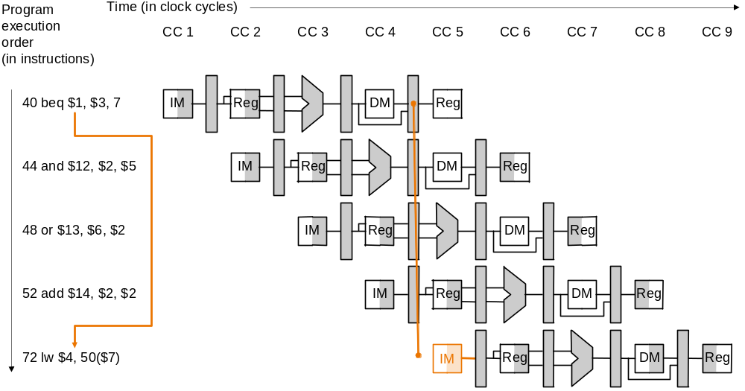
Branch Hazards
Just stalling for each branch is not practical
Common assumption: branch not taken
When assumption fails: flush three instructions
(Fig. 6.37)

Slide 75
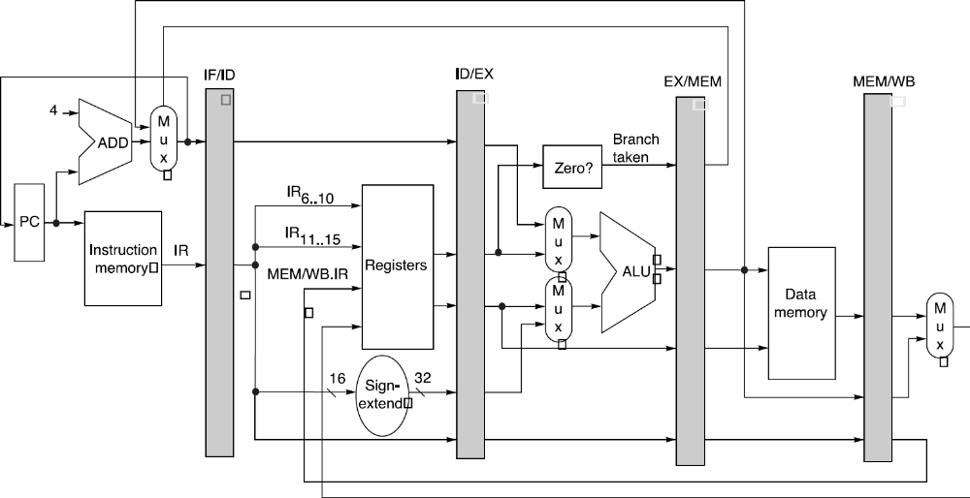
Basic Pipelined Processor
In our original Design, branches have a penalty of 3 cycles

Slide 76
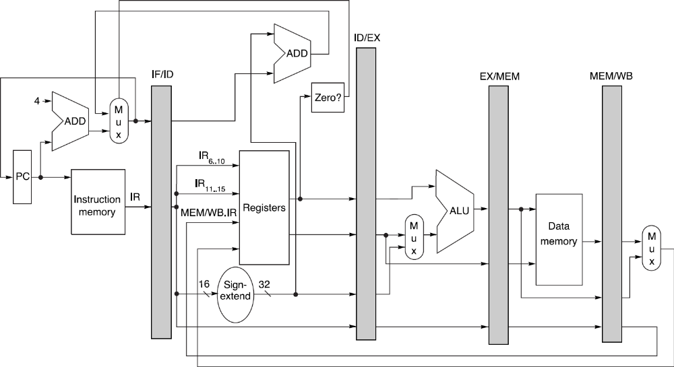
Reducing Branch Delay
Move following to ID stage
a) Branch-target address calculation
b) Branch condition decision
Reduced penalty (1 cycle) when branch take!

Slide 77
Reducing Branch Delay
Key idea: move branch logic to ID stage of pipeline
  New adder calculates branch target
  (PC + 4 + extend(IMM))
  New hardware tests rs == rt after register read
Reduced penalty (1 cycle) when branch take

Slide 78
Control Hazard Solutions
Stall
  stop loading instructions until result is available
Predict
  assume an outcome and continue fetching (undo if prediction is wrong)
  lose cycles only on mis-prediction
Delayed branch
  specify in architecture that the instruction immediately following branch is always executed

Slide 79
Branch Behavior in Programs
Based on SPEC benchmarks on DLX
  Branches occur with a frequency of 14% to 16% in integer programs and 3% to 12% in floating point programs.
  About 75% of the branches are forward branches
  60% of forward branches are taken
  80% of backward branches are taken
  67% of all branches are taken
Why are branches (especially backward branches) more likely to be taken than not taken?

Slide 80
Static Branch Prediction
For every branch encountered during execution predict whether the branch will be taken or not taken.
Predicting branch not taken:
  Speculatively fetch and execute in-line instructions following the branch
  If prediction incorrect flush pipeline of speculated instructions
    Convert these instructions to NOPs by clearing pipeline registers
    These have not updated memory or registers at time of flush
Predicting branch taken:
  Speculatively fetch and execute instructions at the branch target address
  Useful only if target address known earlier than branch outcome
    May require stall cycles till target address known
    Flush pipeline if prediction is incorrect
    Must ensure that flushed instructions do not update memory/registers

Slide 81
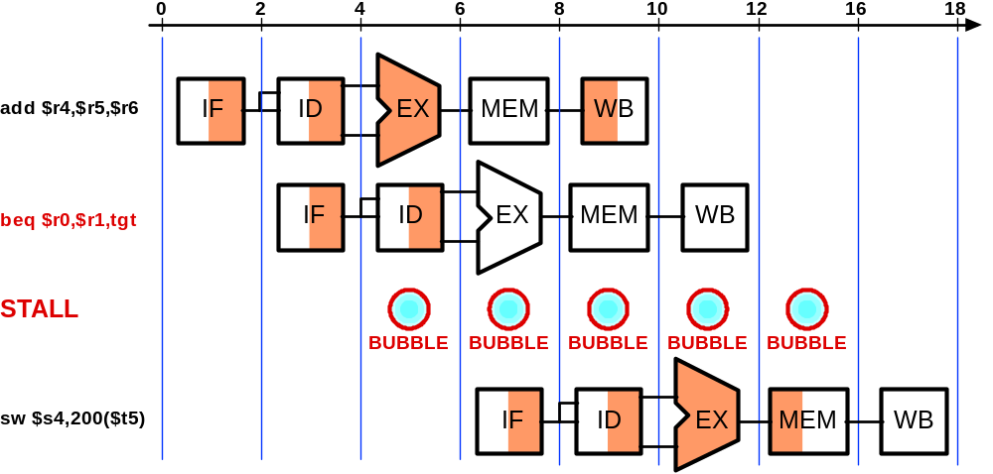
Control Hazard - Stall
beq
writes PC
here
new PC
used here

Slide 82
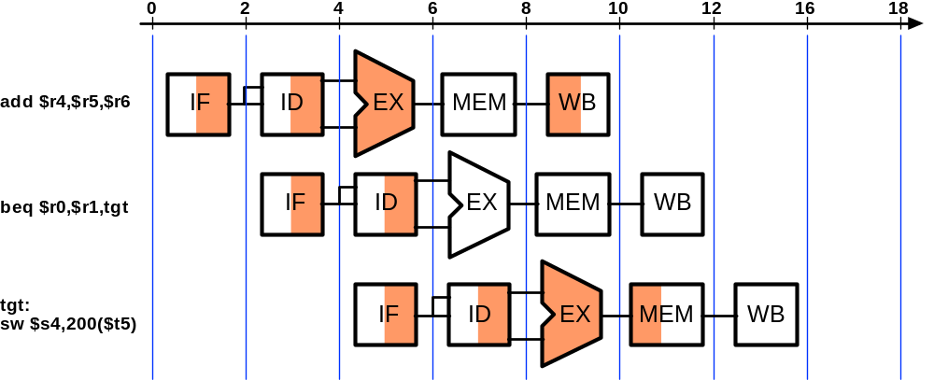
Control Hazard - Correct Prediction
Fetch assuming
branch taken

Slide 83
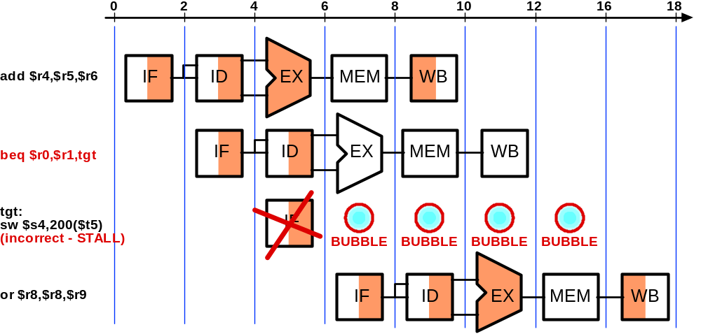
Control Hazard - Incorrect Prediction
“Squashed”
instruction

Slide 84
1-Bit Branch Prediction
Branch History Table (BHT): Lower bits of PC address index table of 1-bit values
  Says whether or not the branch was taken last time
  No address check (saves HW, but may not be the right branch)
  If prediction is wrong, invert prediction bit
  1 = branch was last taken
  0 = branch was last not taken
1
prediction bit
0
a₃₁a₃₀…a₁₁…a₂a₁a₀
branch instruction
1K-entry BHT
10-bit index
1
Instruction memory
Hypothesis: branch will do the same again.

Slide 85
1-Bit Branch Prediction
Example:
Consider a loop branch that is taken 9 times in a row and then not taken once. What is the prediction accuracy of the 1-bit predictor for this branch assuming only this branch ever changes its corresponding prediction bit?
  Answer: 80%. Because there are two mispredictions – one on the first iteration and one on the last iteration. Is this good enough and Why?

Slide 86
2-Bit Branch Prediction
(Jim Smith, 1981)
Solution: a 2-bit scheme where prediction is changed only if mispredicted twice
  Red: stop, not taken
  Green: go, taken
T
NT
Predict Taken
11
10
Predict Taken
T
T
NT
NT
Predict Not
Taken
01
00
Predict Not
Taken
T
NT

Slide 87
n-bit Saturating Counter
Values: 0 ~ 2^{n}-1
When the counter is greater than or equal to one-half of its maximum value, the branch is predicted as taken. Otherwise, not taken.
Studies have shown that the 2-bit predictors do almost as well, and thus most systems rely on 2-bit branch predictors.

Slide 88
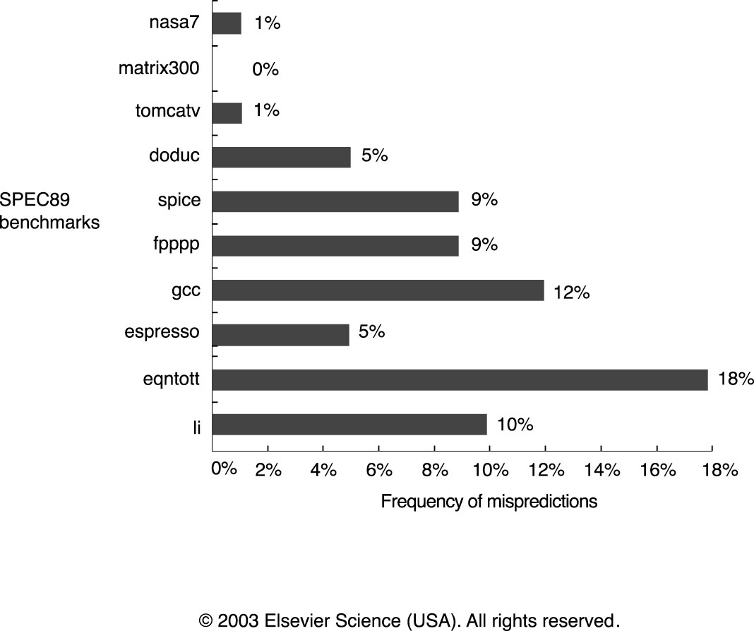
2-bit Predictor Statistics
Prediction accuracy of 4K-entry 2-bit prediction buffer on SPEC89 benchmarks:
accuracy is lower for integer programs (gcc, espresso, eqntott, li) than for FP

Slide 89
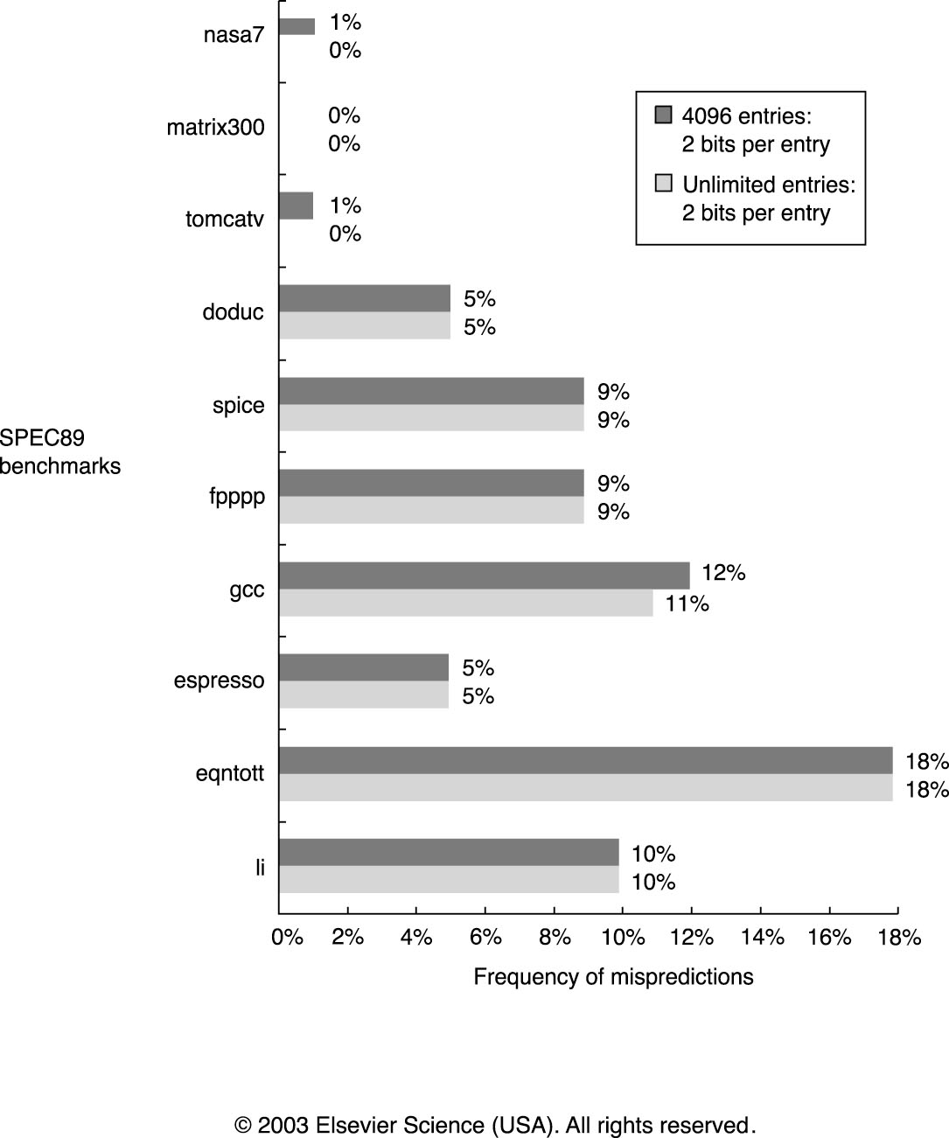
2-bit Predictor Statistics
Prediction accuracy of 4K-entry 2-bit prediction buffer vs. “infinite” 2-bit buffer:
increasing buffer size from 4K does not significantly improve performance

Slide 90
Control Hazards - Solutions
Delayed branches – code rearranged by compiler to place independent instruction after every branch (in delay slot).
add $R4,$R5,$R6
beq $R1,$R2,20
lw $R3,400($R0)
beq $R1,$R2,20
add $R4,$R5,$R6
lw $R3,400($R0)

Slide 91
Scheduling the Delay Slot

Slide 92
Summary - Control Hazard Solutions
Stall - stop fetching instr. until result is available
  Significant performance penalty
  Hardware required to stall
Predict - assume an outcome and continue fetching (undo if prediction is wrong)
  Performance penalty only when guess wrong
  Hardware required to "squash" instructions
Delayed branch - specify in architecture that following instruction is always executed
  Compiler re-orders instructions into delay slot
  Insert "NOP" (no-op) operations when can't use (~50%)
  This is how original MIPS worked

Slide 93
MIPS Instructions
All instructions exactly 32 bits wide
Different formats for different purposes
Similarities in formats ease implementation
6 bits
5 bits
5 bits
5 bits
5 bits
6 bits
op
rs
rt
rd
shamt
funct
R-Format
31
0
6 bits
5 bits
5 bits
16 bits
op
rs
rt
offset
I-Format
31
0
6 bits
26 bits
J-Format
op
address
31
0

Slide 94
MIPS Instruction Types
Arithmetic & Logical - manipulate data in registers
add $s1, $s2, $s3 $s1 = $s2 + $s3
or $s3, $s4, $s5 $s3 = $s4 OR $s5
Data Transfer - move register data to/from memory
lw $s1, 100($s2) $s1 = Memory[$s2 + 100]
sw $s1, 100($s2) Memory[$s2 + 100] = $s1
Branch - alter program flow
beq $s1, $s2, 25 if ($s1==$s1) PC = PC + 4 + 4*25

